Slide 1
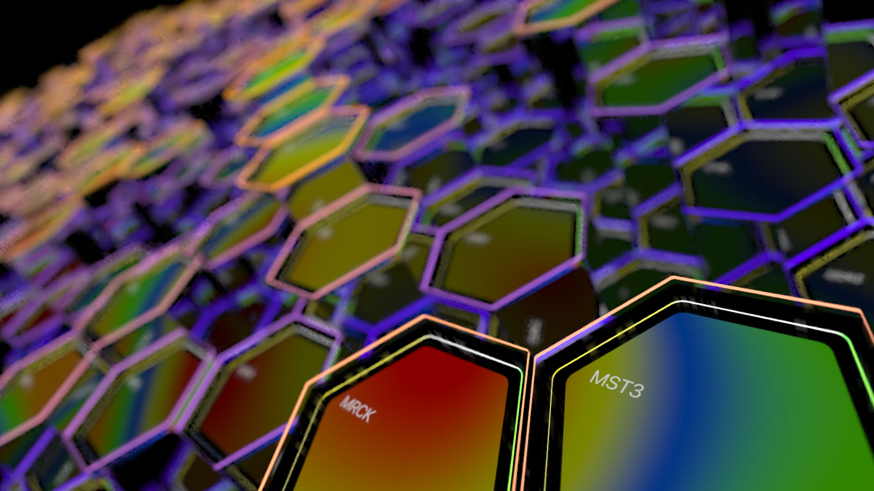
Introduction to Kinexus Proteomics and Bioinformatics Services
Copyright 2025 Kinexus Bioinformatics Corporation
Introduction to Kinexus Proteomics and Bioinformatics Services
Copyright 2025 Kinexus Bioinformatics Corporation

Slide 2
Corporate Profile for Kinexus
Located in Vancouver, Canada, in an 11,000 square foot lab and office facility
Founded in July 1999 as spin-out company from the University of British Columbia
Offers a highly integrated platform of innovative proteomics and bioinformatics services and products to foster cell signalling research
Has provided services to over 3,500 industrial and academic labs in over 40 countries for over 26 years
Notes:
3

Slide 3
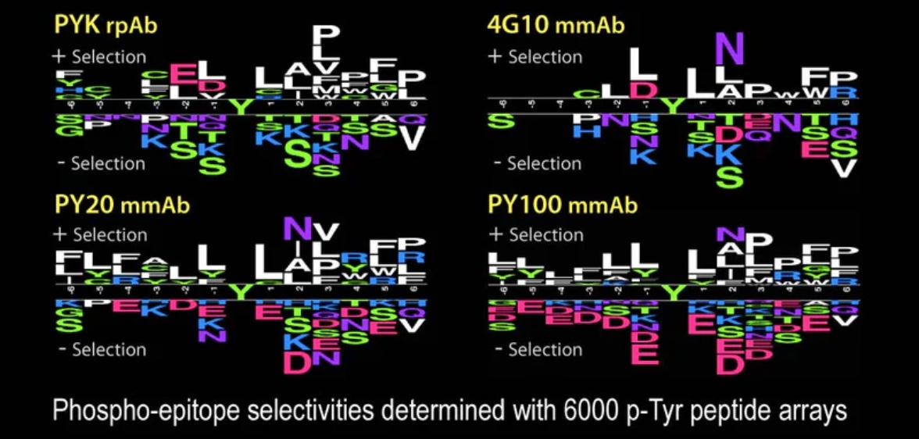
Kinexus Products
Thousands of Kinexus antibody, peptides and tissue/cell lysates are available through
https://kinexus-ca.myshopify.com/
Our quality products are offered at reasonable prices with fair representation and extensive validation
For example, our rabbit polyclonal PYK generic phosphotyrosine antibody is priced at 100 USD for 100 µg.
Notes:
3

Slide 4
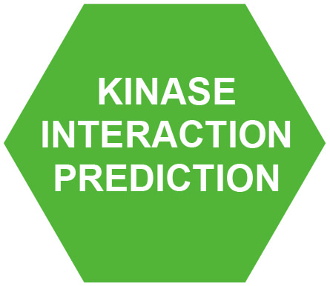



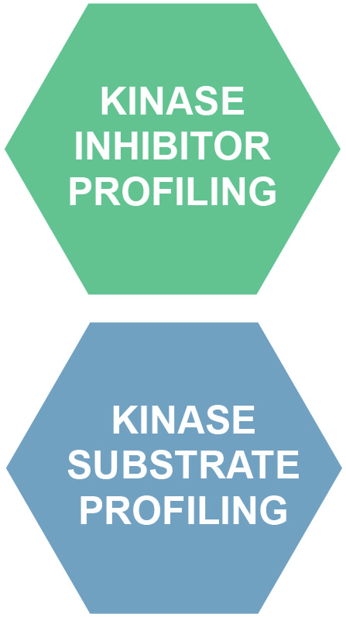

Integrated Proteomics Services
Discovery Platform
IN SILICO
PREDICTION
SERVICES
PROBE
PRODUCTION
SERVICES
KINEX™
ARRAY
SERVICES
KINETWORKS™
MULTI-BLOTTING
SERVICES
IN VITRO
KINASE ASSAY
SERVICES
CUSTOM
GRAPHICS
SERVICES
Our services focus on disease biomarkers, drug targets and drug discovery for oncology, neurology and diabetes
Notes:
3

Slide 5
Complexity of Intracellular Signal Transduction Systems
~21,300 total protein genes
KINASE
ATP
ADP
P
P
P
P
P
PROTEOME
KINASE
KINASE
PHOSPHATASE
PHOSPHATASE
P
PHOSPHATASE
KINASE
H₂O
P
P
P
P
P
ENZYME
ENZYME
ENZYME
ENZYME
ENZYME
ENZYME
INACTIVE
INACTIVE
ACTIVE
ACTIVE
ACTIVE
INACTIVE
PHOSPHO-PROTEOME
PHOSPHATOME
KINEOME
~568 protein
kinase genes
~159 protein
phosphatase genes
~1,000,000 phosphosites
>250,000 confirmed
>1000 catalytically
active protein
kinase isoforms
We specialize in the study of proteins involved in phosphorylation and cell signalling
Notes:
5

Slide 6

PhosphoNET Website
www.phosphonet.ca
One of the open-access Kinexus SigNET knowledgebases
>177,000 confirmed and 790,000 predicted phosphosites in ~21,000 human proteins
Functional information for ~3% of phosphosites
Evolutionary analyses in 20 other species
Kinase specificity prediction
Phosphosite match identification
Links to other related websites
Notes:
5

Slide 7
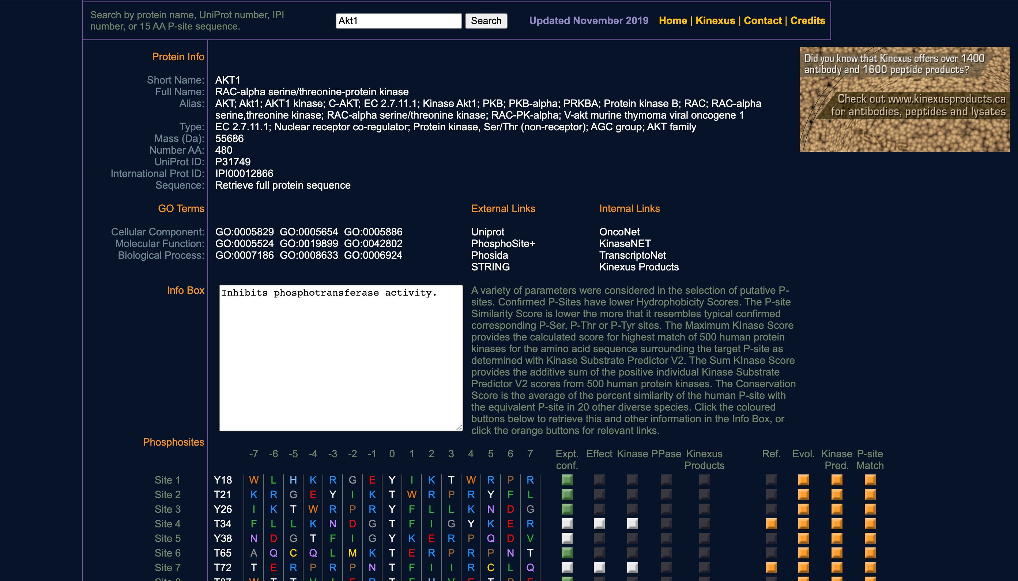
PhosphoNET Website
www.phosphonet.ca
IN SILICO
PREDICTION
SERVICES
Our open-access PhosphoNET website provides predictions of phosphosites and the kinases that phosphorylate them
Notes:
3

Slide 8
Comparison of empirical and predicted kinase specificities
Experimental and predicted kinase consensus sequence
Empirical
Predicted
Kinase
-5
-4
-3
-2
-1
0
1
2
3
4
5
-5
-4
-3
-2
-1
0
1
2
3
4
5
Abl
x
n
d
x
x
Y
x
x
P
x
x
x
n
D
d
e
Y
f
r
P
x
e
Akt1
R
r
R
r
x
S
f
x
x
s
x
R
s
R
R
l
S
F
r
r
s
x
CaMK2a
l
s
R
q
x
S
l
d
x
x
x
L
s
R
q
d
S
f
d
r
s
x
CDK1
x
x
l
p
x
S
P
x
k
k
x
r
s
r
P
l
S
P
x
K
k
x
CDK2
x
x
x
p
x
S
P
g
K
k
x
r
s
R
P
l
S
P
x
K
k
p
CDK5
x
s
x
p
l
S
P
x
k
x
x
r
s
r
P
d
S
P
x
K
k
x
CK1a1
x
x
d
d
d
S
x
x
g
x
x
l
s
R
R
a
S
p
x
g
x
x
CK1d
x
x
ps
x
a
S
x
x
x
x
x
l
s
S
r
a
S
p
x
s
x
x
CK2a1
x
e
e
e
d
S
D
d
E
e
e
r
e
e
p
d
S
D
d
E
E
e
ERK1
p
p
p
P
l
S
P
t
p
t
x
p
S
P
P
L
S
P
t
p
p
t
ERK2
p
x
p
P
l
S
P
t
p
p
x
p
s
P
P
L
S
P
t
p
p
t
Fyn
x
x
x
x
v
Y
x
x
v
x
x
x
e
D
d
v
Y
p
r
p
x
x
GSK3b
x
S
p
p
p
S
P
p
p
S
p
r
s
r
P
p
S
P
p
p
s
p
InsR
x
e
x
d
d
Y
m
x
M
x
x
x
e
r
d
d
Y
v
d
v
x
x
JNK1
x
s
a
l
x
S
P
x
a
x
x
r
S
R
L
L
S
P
x
p
x
x
Lck
x
x
d
d
l
Y
x
x
v
x
x
l
e
D
d
l
Y
v
r
p
x
p
Lyn
x
x
e
n
I
Y
e
x
p
x
x
r
e
D
d
l
Y
f
x
p
t
x
p38a
x
x
x
P
l
S
P
x
x
p
x
l
S
R
P
L
S
P
x
p
p
t
PAK1
x
x
R
R
r
S
v
x
g
x
l
r
s
R
R
k
S
v
r
g
k
l
PKACa
r
x
R
R
l
S
l
x
x
x
x
R
s
R
R
l
S
l
r
s
s
t
PKCa
x
x
R
R
x
S
f
K
r
k
k
r
s
R
R
k
S
F
R
r
k
x
PKCb1
x
f
r
r
k
S
f
R
x
x
x
r
s
R
R
k
S
F
R
r
r
k
PKCd
x
x
R
R
x
S
f
R
r
x
x
r
s
R
R
k
S
F
r
r
r
x
PKCe
x
k
R
R
k
S
f
R
r
r
x
R
s
R
R
K
S
F
R
r
r
k
PKCz
x
x
r
r
k
S
F
r
r
x
x
R
s
R
R
K
S
F
R
r
r
x
PKG1
r
x
R
R
x
S
x
x
x
v
x
R
s
R
R
l
S
f
d
r
s
x
Plk1
l
x
l
d
d
S
x
v
x
x
x
r
s
R
p
d
S
f
t
p
x
x
ROCK1
r
x
r
R
x
S
x
v
x
x
x
R
s
R
R
l
S
v
k
v
s
x
Src
x
e
e
d
v
Y
g
x
v
x
x
x
e
D
d
v
Y
p
r
p
x
x
Syk
d
d
d
d
D
Y
E
x
p
x
e
r
e
D
d
D
Y
E
r
P
x
e
Notes:
5

Slide 9
PhosphoNET Website
www.phosphonet.ca
PROBE
PRODUCTION
SERVICES
Amino Acid Substitution Analyses
Kinexus can synthesize soluble peptides to serve as antigens for antibody production and peptides in SPOT arrays to test the specificity of the antibodies generated with these antigenic peptides
pSer Ab
pThr Ab
pTyr Ab
WT pS pT pY S T Y E
Phosphosite Position Substitution
Examples of testing the phosphosite-specificity of three Kinexus antibodies
Notes:
5

Slide 10
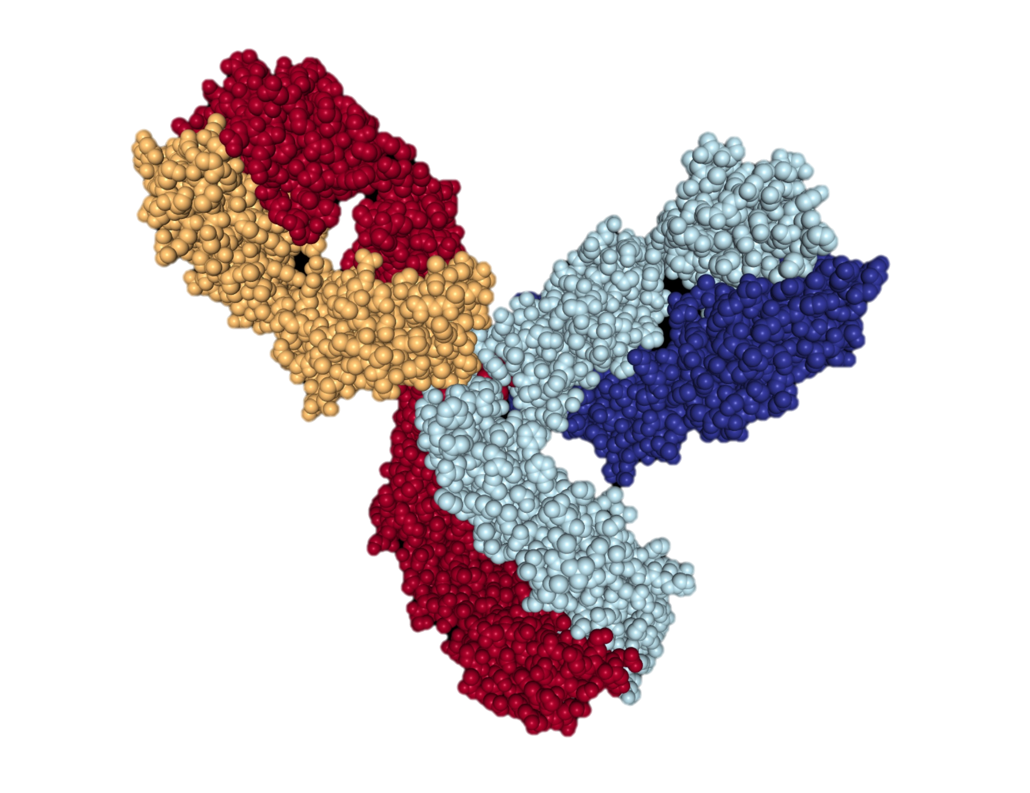
Custom Antibody Production Service
PROBE
PRODUCTION
SERVICES
Antigen peptide sequences are selected from our bioinformatics program based on established functional importance, evolutionary conservation and frequency of mass spectrometry reports
Peptides are synthesized in-house and KLH-coupled
Rabbits are immunized every 2 weeks for 4 months before body bleed
Antibodies are purified by peptide affinity chromatography
Median yield is 1.5-2 mg of affinity-purified antibody
IgG structure
Notes:
2

Slide 11
Kinex™ KAM Antibody Microarrays
ANTIBODY
MICROARRAY SERVICE
KAM-2025 antibody
microarray image –
right and left fields
Kinexus services use over 2,000 antibodies cherry-picked from over 26 vendors and validated in-house as well as over 1,600 antibodies produced in-house
1,047 of these antibodies target phosphosites
Focus is on low abundance cell signalling proteins, including protein kinases, protein phosphatases, transcription factors, stress, cell cycle and apoptosis
Notes:
5

Slide 12
KAM-2025 Antibody Microarray
Latest Generation Microarray
2026 antibodies pin-printed array on 3D matrix coated glass slide @ 100-400 pg IgG/spot in quadruplicate
Two lysate samples separately analyzed per slide in duplicate - both lysate samples are prepared with the same label
Mean variation in duplicate samples is within ~5-6%
Very high signal to noise ratio
Over 2,000-fold dynamic range
Cell mix - untreated
Cell mix + Alkaline Phosphatase
Notes:
5

Slide 13
Custom Macroarray Production
ANTIBODY
MACROARRAY SERVICES
Kinexus can produce custom arrays of 200 or more spots on to glass slides or nitrocellulose membranes
Printing can be performed with peptides, antibodies and cell/tissue lysates
Kinexus offers a large panel of in-house produced peptides, antibodies and cell/tissue lysates that can be used in these services
Close-up of overlay of two peptide arrays probed with
different antibodies
Notes:
5

Slide 14
Kinetworks™ Multi-Immunoblotting
KINETWORKS™
MULTI-BLOTTING
SERVICES
Uses SDS-PAGE with a single sample of cell or tissue lysate
One wide lane across entire gel
Proteins are resolved by SDS-PAGE and transferred to a nitrocellulose membrane
Membrane is incubated with panels of antibodies with a multi-blotter manifold
Rat Lung Custom Multi-Blot
Notes:
3

Slide 15
Mass Spectrometry
Antibody Cross-reactive Protein ID
PROBE
PRODUCTION
SERVICES
Our antibody microarray and Western blotting services often reveal cross-reactive proteins that may be profoundly affected in expression or phosphorylation by a treatment
Our mass spec services can identify these leads
90
80
70
60
50
40
30
20
10
0
0
200
400
600
800
1000
1200
Mass to Charge Ratio (m/z)
Notes:
5

Slide 16
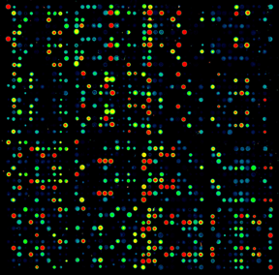
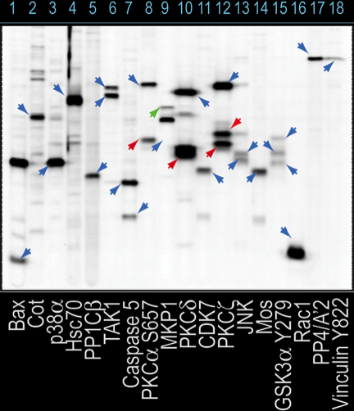
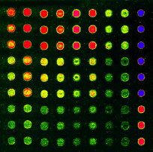
Kinexus Biomarker Platform
From Discovery to Validation
KINEX™
Antibody Microarrays
Biomarker Probe
Discovery
KINETWORK™
Custom Multi-Immunoblotting
Biomarker Probe
Validation
KINEX™
Custom Reverse Lysate Macroarrays
Biomarker Biological
Validation
Notes:
3

Slide 17
Kinase and Phosphatase Substrate
Profiling with Immunoglobulin
Microarray Analysis (SPIMA)
Identifies substrates of selected kinases or phosphatase in cell or tissue lysates
Over 350 kinases and phosphatases available
Initial microarray screen with 1047 phosphosite-specific antibodies for phosphorylation changes with added kinase
Final in silico prediction filter to identify high quality substrate leads
IN VITRO
KINASE ASSAY
SERVICES
Notes:
3

Slide 18
Kinase Inhibitor
Displacement Microarray-based
Screen (KIDMAS)
IN VITRO
KINASE ASSAY
SERVICES
Most kinase inhibitors are ATP analogues
KIDMAS identifies with active kinases captured on antibody microarrays test compounds that competitively inhibit binding of FSBA-biotin
Hundreds of kinases can be screened simultaneously against a compound for inhibition
FSBA is an ATP analogue that covalently binds to proteins that interact with ATP via its reactive FO₂S group (which reacts with free amines
Kinase inhibitors block binding of FSBA
Notes:
3

Slide 19
www.drugkinet.ca KnowledgeBase
Open access human protein kinase drug knowledgebase
Features experimental results for over 105,000 kinase drug pairs (>450 kinases, >850 compounds that inhibit kinases)
Features predictive data for another 200,000 kinase-drug pairs
Information and links to other websites provided about each drug
Identification of critical kinase residues in drug interactions from 3D structural information

Slide 20
DrugKiNET KnowledgeBase
www.drugkinet.ca
Generates 2 downloadable tables
Interaction Summary table identifies the most critical kinase residues involved in drug interaction
Full Interaction List identifies the distances in Angstroms between each amino acid residue atom and each drug atom

Slide 21
DrugProNET KnowledgeBase
www.drugpronet.ca
DrugProNET features comprehensive information on over 2000 compounds that have been co-crystallized with over 480 different human proteins in over 4400 protein-compound structures retrieved from the RCSB Protein Databank. In addition, information is also available for an additional 748 compounds that are inhibitors of protein kinases
The bond distances in Angstroms between the closest protein and drug atoms in each crystal complex are provided. Single nucleotide variants (SNV’s) that would affect these critical amino acid residues involved in drug interactions are also predicted in DrugProNET
Notes:
5

Slide 22
Other Kinexus Bioinformatics Websites
Kinexus has created a series of open-access “omics” data-bases under the SigNET umbrella related to cell signalling
Notes:
3

Slide 23
KinaseNET Website
www.kinasenet.ca
Open-access KinaseNET features comprehensive information on over 530 human protein kinases, including their structures, regulation, substrates, tissue distribution, evolutionary conservation, sensitivities to compounds, and linkages to other related websites
Notes:
5

Slide 24
OncoNET and TranscriptoNET Websites
www.transcriptonet.ca
and www.onoconet.ca
Open-access TranscriptoNET features information on the mRNA expression levels from DNA microarray studies for over 20,000 genes in about 600 types of human organs, tissues and cells from over 900 studies with 6,000 biological specimens deposited in the NCBI GEO website
Open-access OncoNET is a cancer protein-focused knowledgebase with data on the expression levels and mutations in about 3,000 human proteins that are linked to cancer in diverse human tissues and tumour cell lines
Notes:
5

Slide 25
KiNECTOR Pathway Mapping Website
www.kinector.ca
Open-access KiNECTOR features over 22,000 direct kinase-substrate relationships as well as indirect connections between kinases and phosphoproteins within four degrees of connectivity in signalling maps with direct links to other informative website
The new CytoNET module of KiNECTOR documents over 4,000 human cell receptor interactions (RIs) directly with extracellular mediators and intracellular proteins
Notes:
5

Slide 26
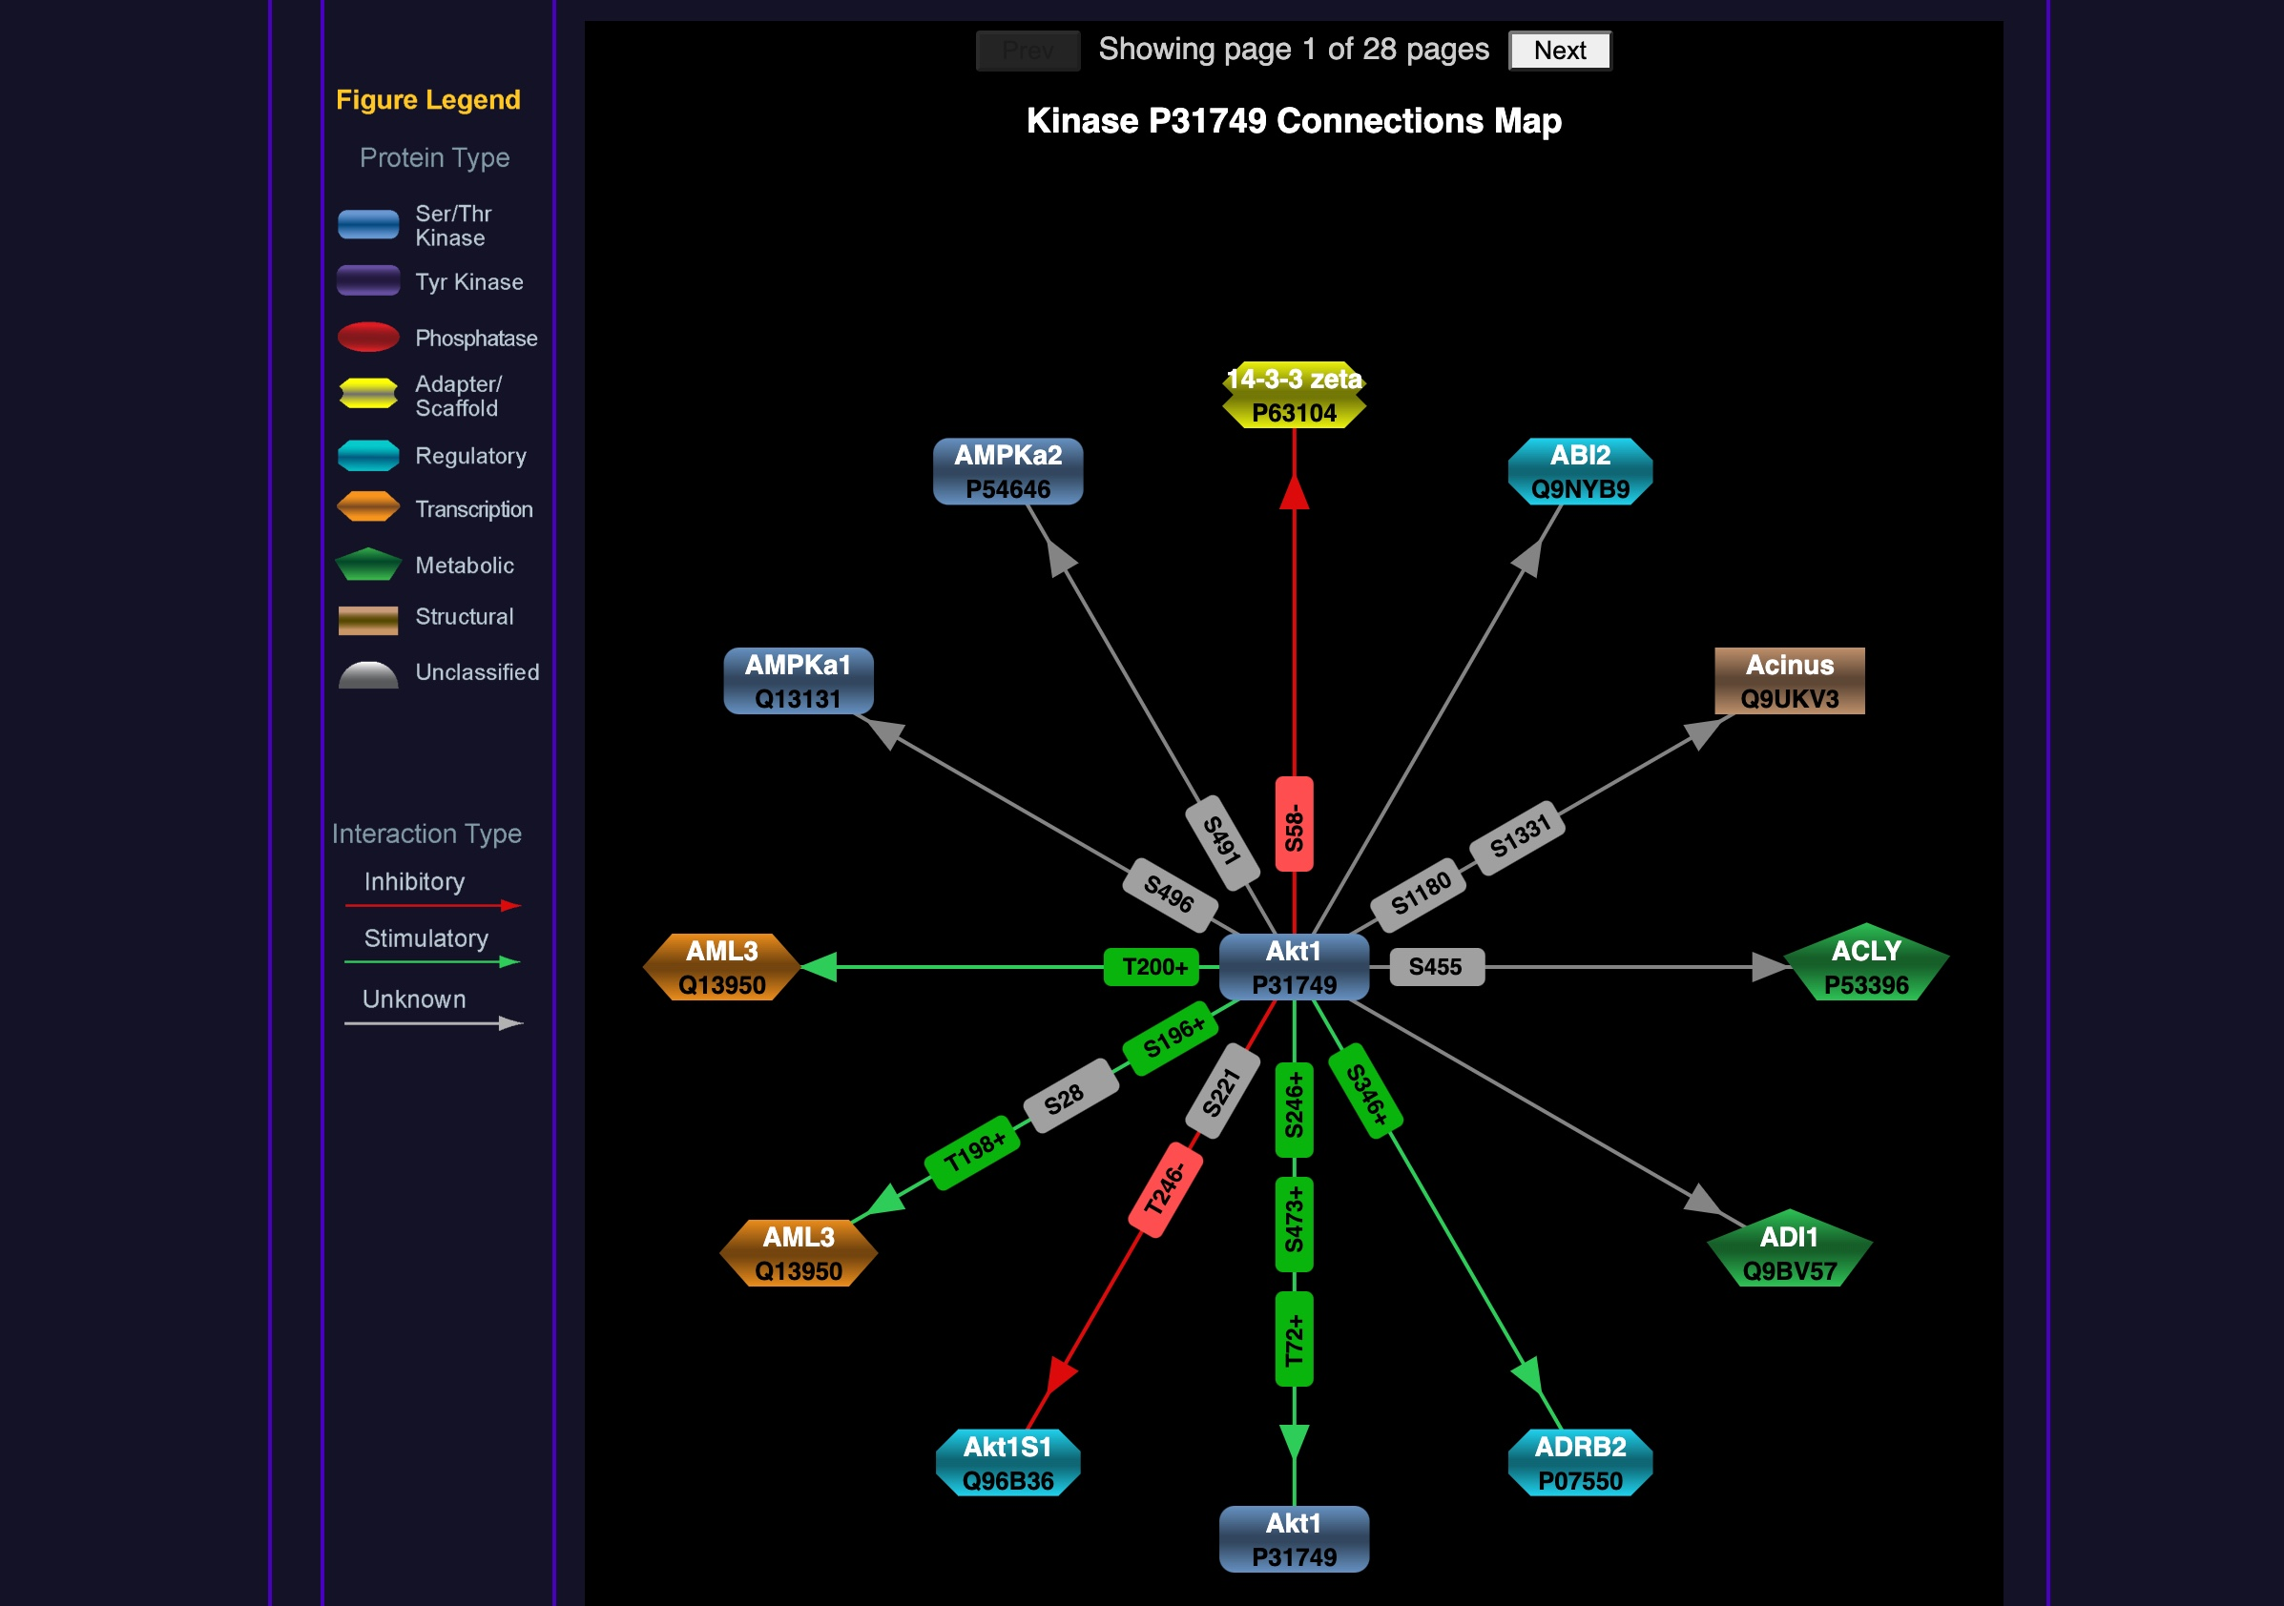
Kinector Pathway Mapping Website
www.kinector.ca
Notes:
5

Slide 27
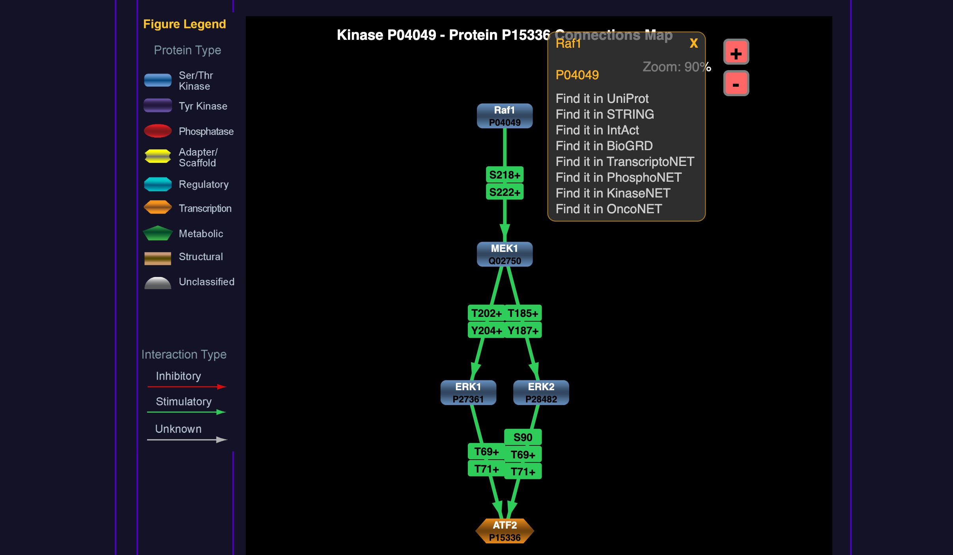
Kinector Pathway Mapping Website
www.kinector.ca
Notes:
5

Slide 28
Contact Information
Dr. Steven Pelech
spelech@kinexus.ca
1-604-323-2547 ext. 10
Kinexus Bioinformatics Corp.
Suite 1, 8755 Ash Street
Vancouver, B.C.
Canada V6P 6T3
Phone: 1-604-323-2547
Facsimile: 1-604-323-2548
E-mail: info@kinexus.ca
Website: www.kinexus.ca
Notes:
30

